Slide 1
Ultrasonic-Based Non-Destructive Testing Using Machine Learning for Flaw Detection and Localization

Slide 2
Introduction
Non Destructive Testing is a type of technique that detects the defects in the material without destroying the material with the help of ultrasonic sensors.
Currently it is employed in many industries such as marine industries with Classical CRO display which is high cost and it create some noise disturbance.
Here Modern Display, Raspberry Pi 4 and the Ultrasonic sensor are integrated to perform the Non Destructive Testing for the surface of the material and within the material.
The goal is to offer an automated, accurate flaw detection solution for enhanced quality control and safety standards in diverse industrial applications.

Slide 3
Scope of the Project
The transition from traditional to AI-driven displays enables real-time analysis, empowering quick decision-making.
With the help of high frequency ultrasonic sensors ,it defects the flaws present in high dense material
The flaw detection system, overcoming integration challenges, promises enhanced quality control and safety standards, marking a substantial leap in NDT methodologies.

Slide 4
Methodology
It involves ultrasonic sensor integration, data collection, and machine learning (ML) for efficient flaw detection. Ultrasonic sensors connected to the Raspberry Pi 4 measure distance and time of flight, with collected data processed to identify potential flaws.
Machine Learning model, ideally implemented using NumPy, is trained on the collected data to automatically detect flaws based on distance measurements exceeding a threshold. The depth of detected flaws is calculated using the time of flight and the speed of sound in the inspected material.
The proposed solution follows a systematic approach, storing detected flaws, their depth, and position in a list for efficient reporting.
It addresses integration challenges by implementing careful calibration processes and continuous validation against established standards. The graphical representation of NDT data is enhanced through AI-driven displays, facilitating real-time analysis and dynamic visualization for swift decision-making.

Slide 5
Methodology
Test cases, including readings, graphs, and images, validate the effectiveness of the proposed flaw detection system. This methodology represents a significant advancement in NDT methodologies, contributing to improved quality control and safety standards across various industrial applications.
By seamlessly integrating ultrasonic sensors and Raspberry Pi 4, this project not only advances flaw detection but also contributes to Industry 4.0. The combination of machine learning, meticulous calibration, and dynamic graphical representation marks a holistic approach to Non-Destructive Testing (NDT).
The systematic flaw documentation, real-time analysis, and improved visualization promise heightened operational efficiency and safety across various industrial sectors, emphasizing the project's relevance and impact on cutting-edge quality control standards.

Slide 6
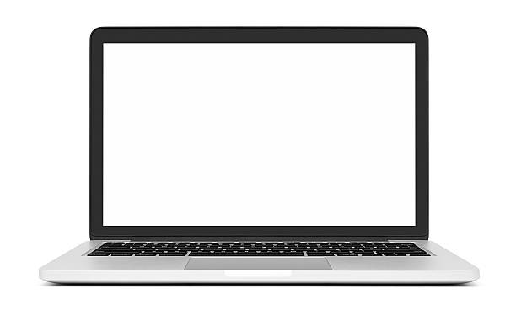
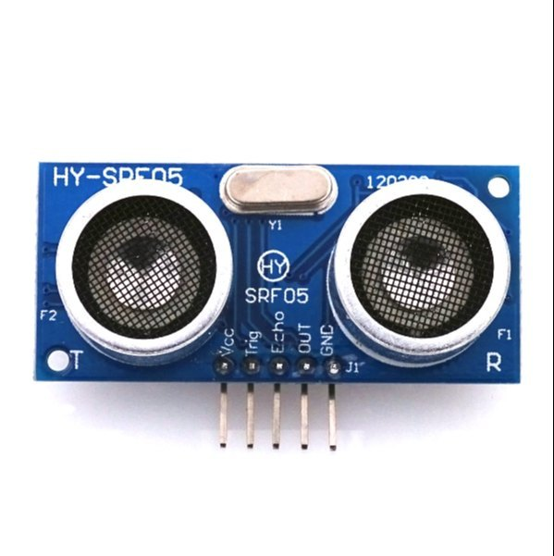
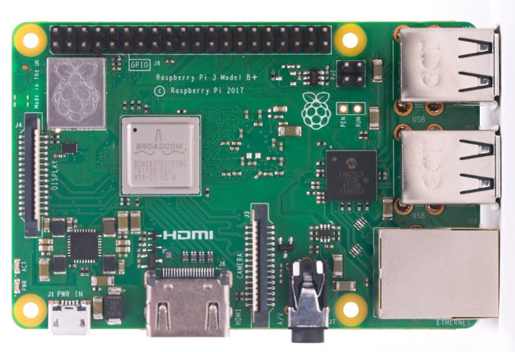
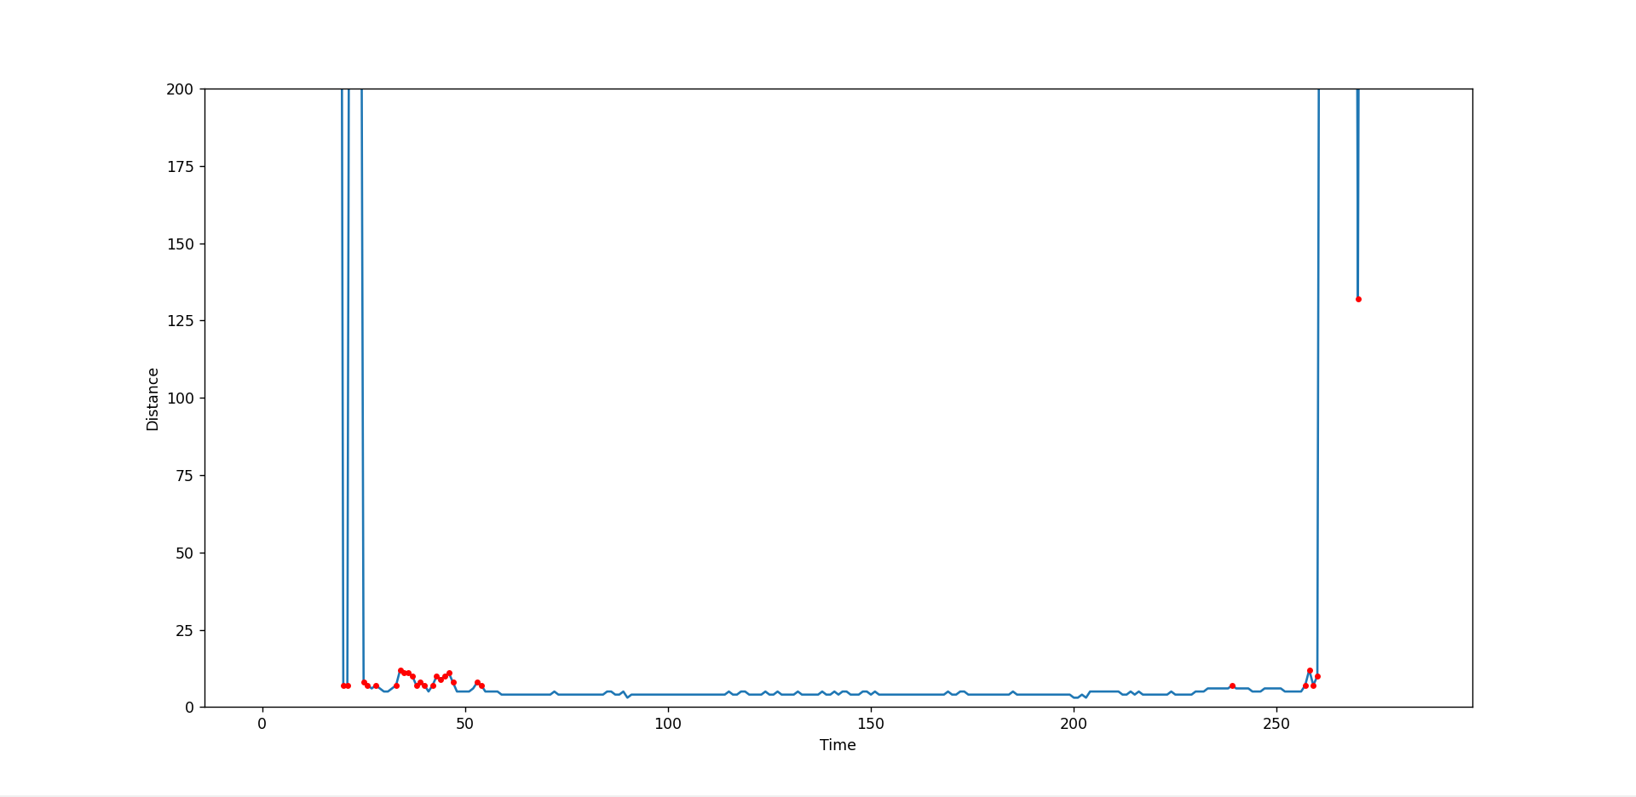
Block Diagram
Ultrasonic Sensor
Raspberry Pi 4
Display
Calculate the Distance & Time
Transfer the data
Take data as input
Output
The graphical representation of data

Slide 7
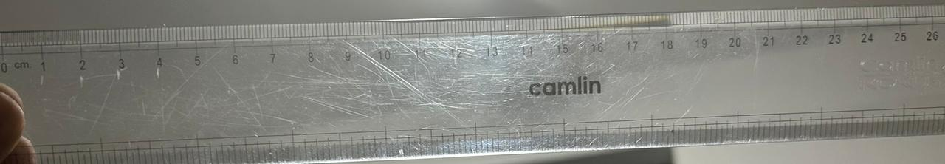
Result
Material with defect
In this graphical representation, the dots in Z Pulse determines the defects present in the material .
. : Defect point
x-axis : Time(sec)
y-axis : Distance(mm)

Slide 8
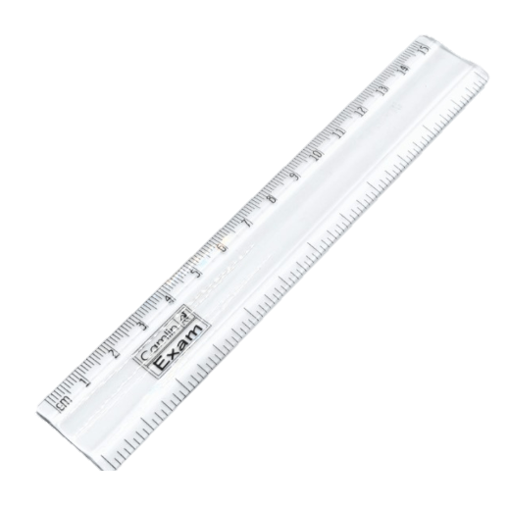
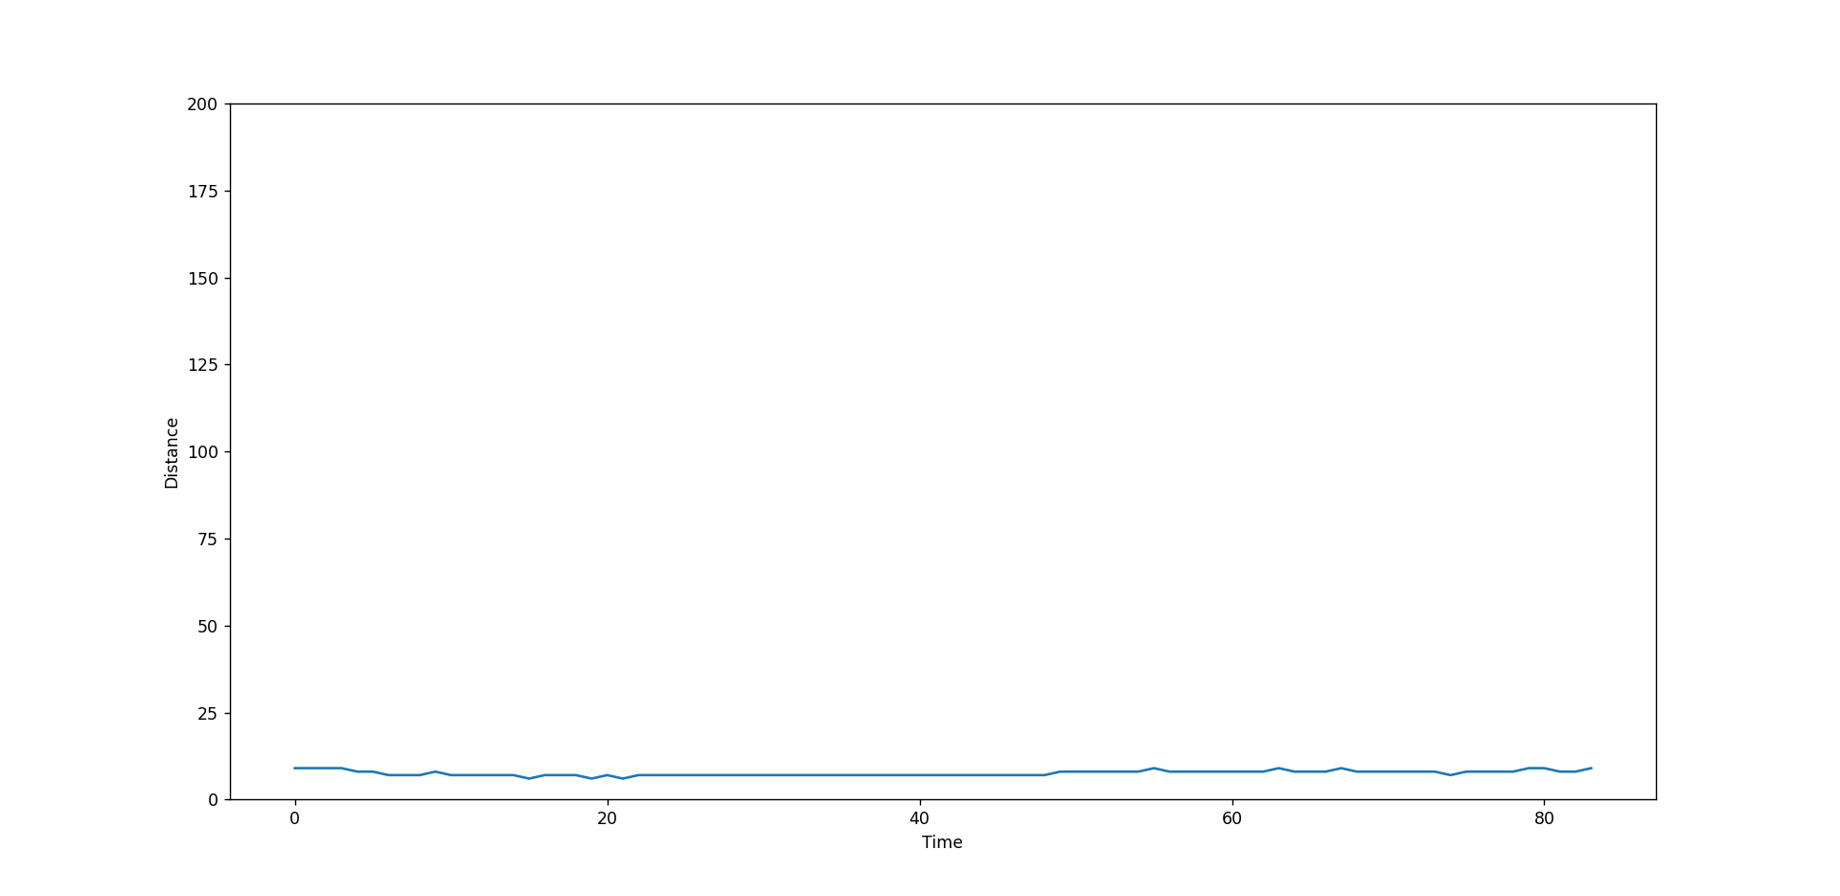
Result
Material without defect
In this graphical representation , there is no Z Pulse which determines the absence of the defects in the material.
x-axis : Time(sec)
y-axis : Distance(mm)

Slide 9
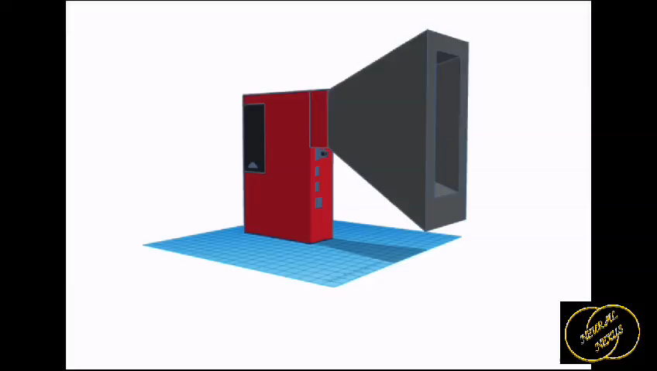
Working Demo

Slide 10
Summary
It detects flaws in objects providing real-time graphical representation and enhancing operator decision-making.
It determines the position and defects that present in the material with the help of ultrasonic sensor.
It has frequency of 40KHz and covers the distance of 2-400cm from the sensor.
With meticulous integration, the project contributes to improved quality control, safety standards, and proactive maintenance in diverse industrial applications.
At present it has ability to detect defects in low dense material, In future by including high frequency ultrasonic sensor and Improved ML algorithm it can used to detect flaws in high dense material

